Slide 1
Employee Data Analysis using Excel
STUDENT NAME: A.nikki kushwaha
REGISTER NO: 312211251
DEPARTMENT: B come general
COLLEGE : DR,MGR Janaki college of arts and science for women’s

Slide 2
PROJECT TITLE
Employee Performance Analysis using Excel

Slide 3


AGENDA
Problem Statement
Project Overview
End Users
Our Solution and Proposition
Dataset Description
Modelling Approach
Results and Discussion
Conclusion
3/21/2024 Annual Review

Slide 4

PROBLEM STATEMENT
1 employees analysis is more important
To find his /her managing skill of work and
For the appreciation and for good Achievement
and his attendance.
How they admire in project
Notes:
1 employees analysis is more important
To find his /her managing skill of work and
For the appreciation and for good Achievement

Slide 5

PROJECT OVERVIEW
.
Analyzing the employee Is known as various factors by
Consider like Gender , performance base And achievements
And ratings .
This is what called as data analytics of employees

Slide 6

WHO ARE THE END USERS?
Manager
Employees
Employers
Organization
Various IT field
These are the end users.

Slide 7

OUR SOLUTION AND ITS VALUE PROPOSITION
Conditionals formatting
Missing values highlights
Filtering
Formula
To calculate the performance of employee
Pivot table - for summary
Graph
Data visualizations

Slide 8
Dataset Description
1 employees analysis is more important
To find his /her managing skill of work and
For the appreciation and for good Achievement
Employee data set
From 26 features
Only consider 9 features
1 Employee Id
(In form of numerical values)
2 Employee name
3 Employee type
4 Performance level
5 Gender
(male/female )
6 Employee rating
(In numerical value)

Slide 9

THE "WOW" IN OUR SOLUTION
Performance level =ifs(z8>5,”very High “,z8>=4,
“high ”,z8=3,“MED”.True , “Low”)
3/21/2024 Annual Review
9

Slide 10
MODELLING
1 Data analytics
2 Employee performance
3 Employee achievements
4 Format
5 Self introduction
6 Interviewing process
7 Wow moment
8Codes
9 Graph
10
Notes:
It a good

Slide 11
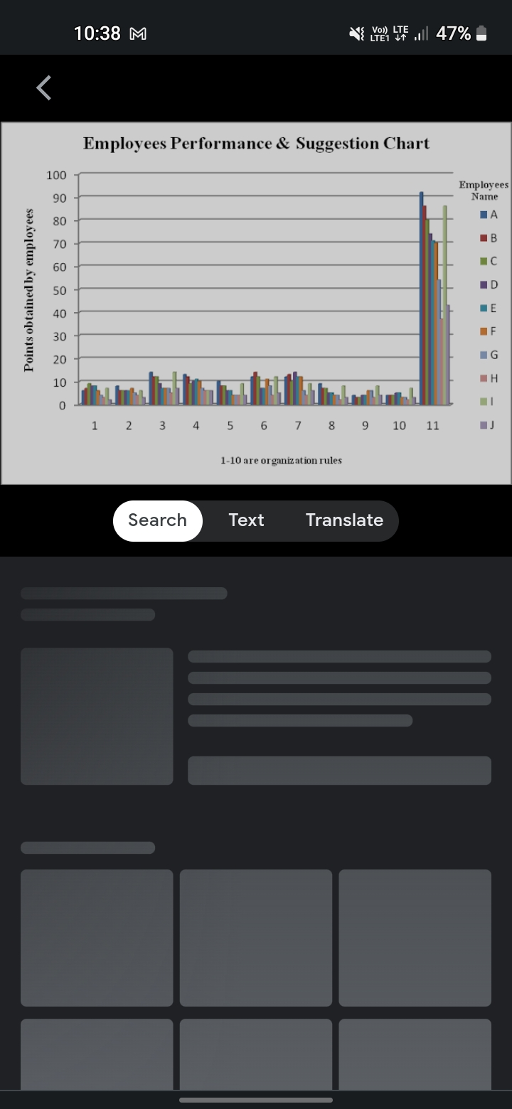
RESULTS
11

Slide 12
conclusion
From the results given in the graph
That the each employee performance in their
Organization.
In that comparing to others Mr. H had
Performance best and in has good
Suggest.
Notes:
Hi

